Slide 2
AGM 2020
Agenda
Welcome -
Committee named roles assignment -
Finance review of 2019/20 -
Adventure playground funding project -
2020/21 fundraising goals and event calendar -

Slide 3
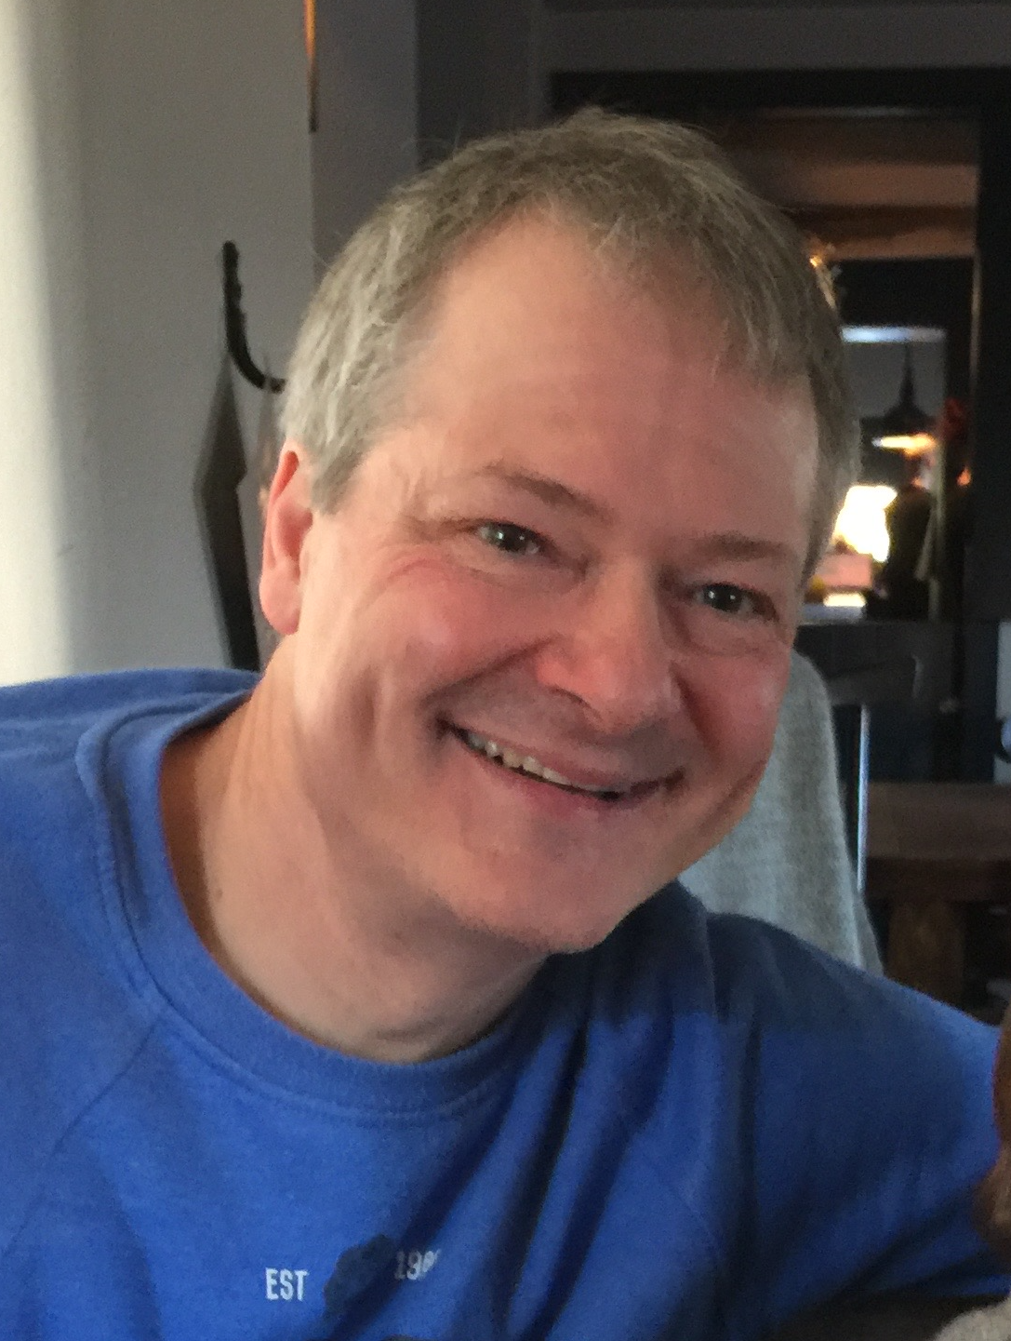
Juniper Hill PTA - Committee roles
Zoe Wishman & Zoe Bourn - Co Chair
Troy Emery - Treasurer
Chris Smith - Secretary

Slide 4
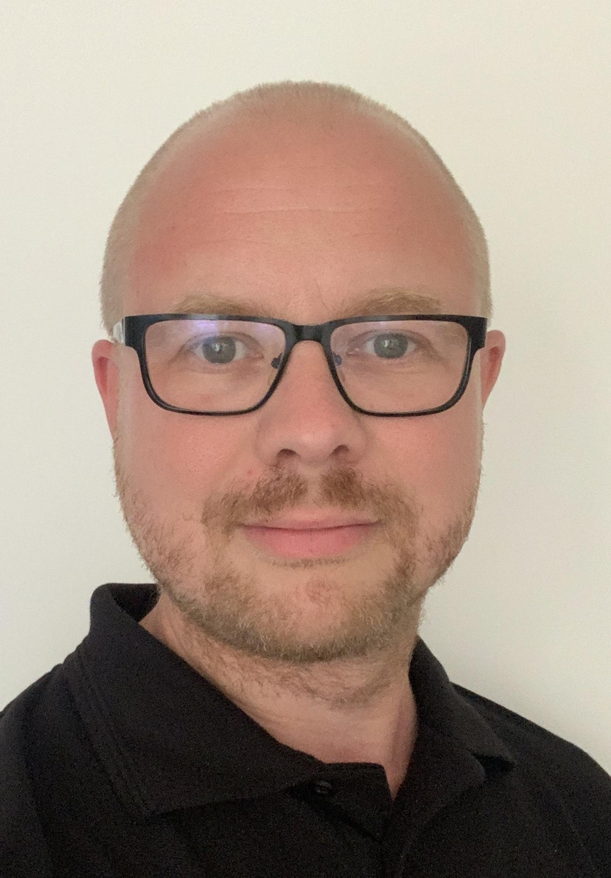
Juniper Hill - Committee roles
Chris Marriott - Grants & Sponsorship Manager
Imogen Carey - Health & Safety Officer

Slide 5
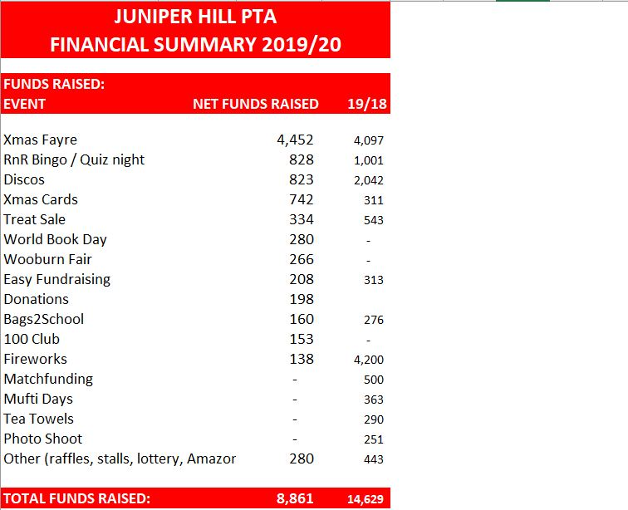
Finance summary 2019/2020

Slide 6
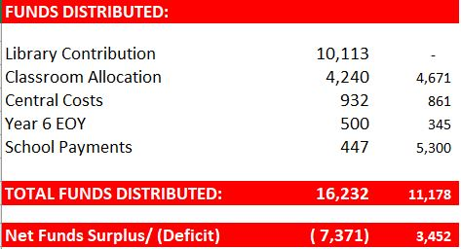
Finance summary 2019/20

Slide 7
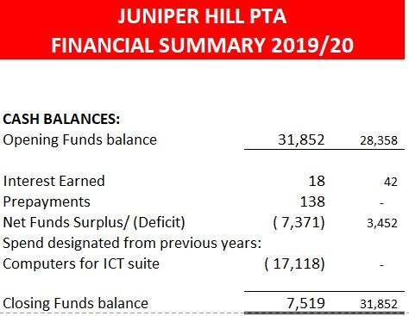
Finance summary 2019/20

Slide 8
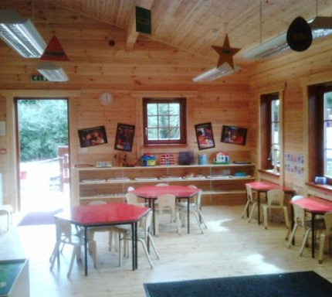
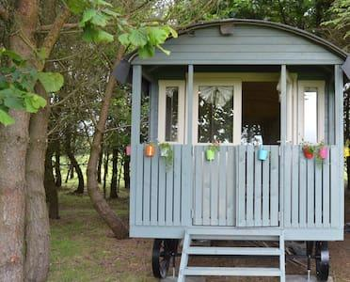
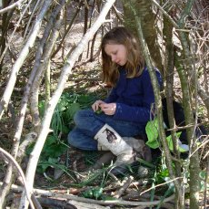
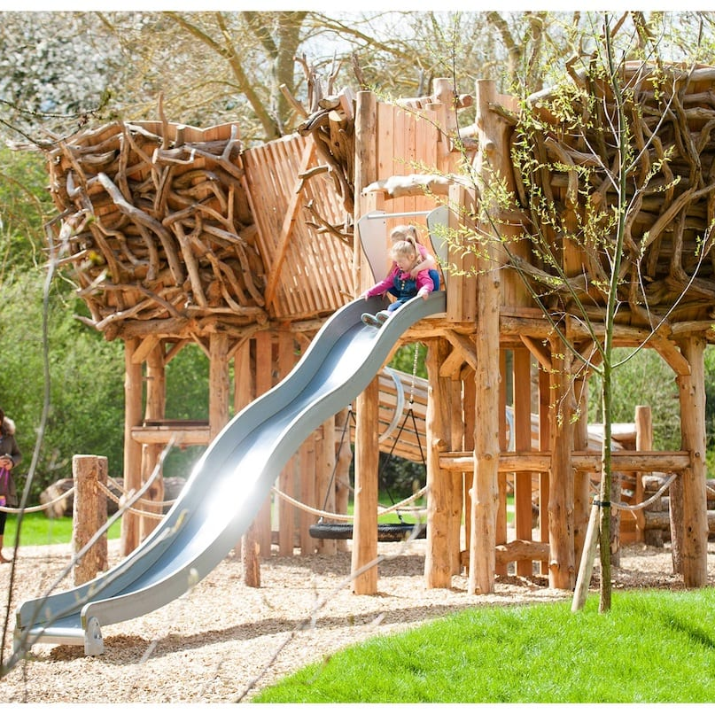
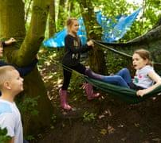
Our vision for Juniper Hill’s
Adventure Playground

Slide 9
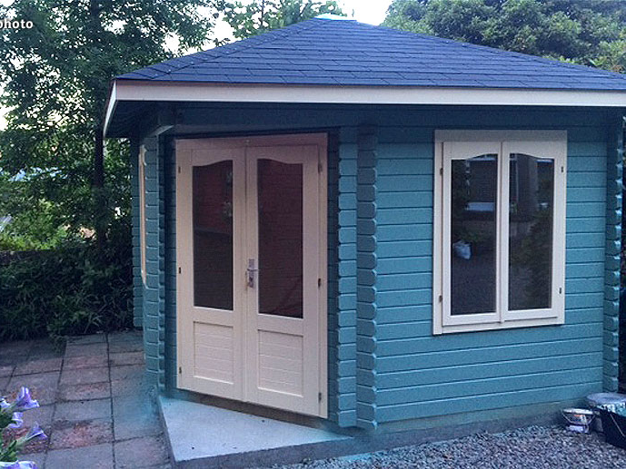
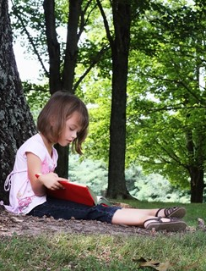
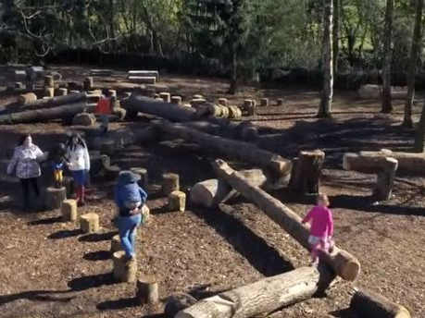
Adventure Playground project timeline
Phase 1 - 2020 - New fencing / Tarmac / Grass beneath trees
Funding - £6,000 (2019/20 funds plus recent parent donations and Dunelm Mill support)

Slide 10
FUNDRAISING GOALS
Phase 2 - 2021 (New equipment)
Fundraising goal 2020/21 - £10,000 (Allowing for Covid restrictions)
Phase 3 - 2022 (Cabins for nurture group/music lessons/breakout sessions/SEN space etc)
Fundraising goal 2021/22 - £15,000 (Based on less restrictions we hope!)

Slide 11
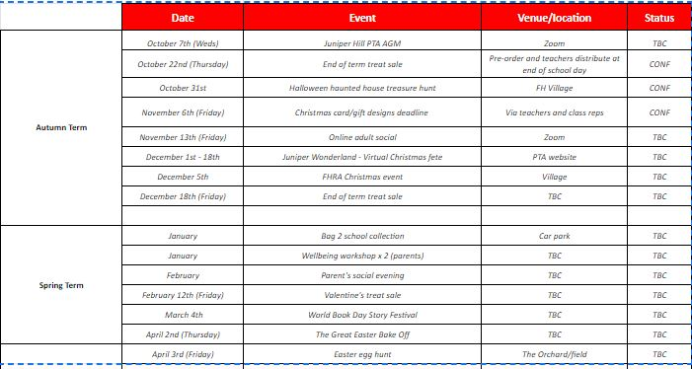
2020/21 EVENT CALENDAR

Slide 12
HOW CAN YOU HELP?
VOLUNTEER
BE CREATIVE!
LEND YOUR EXPERTISE
DONATE
We have between 10 and 20 events every year that need people power to make them happen.
There are lots of ways to get involved – from managing an event, to serving tea or being a steward.
We’ll always be as clear as we can about the time a volunteer role will take, and what you’ll need to do.
Look out for opportunities to volunteer in the weekly PTA newsletter.
Follow us on socials!
Suggest new ways we could do things – or new events we could run!
Bake, make, create!
We’re looking to host a series of workshops in 2021 where you can promote your creative business, while supporting the Juniper Hill PTA. If you’d like to host a workshop to support the PTA please do email us.
We’re also always looking for creative bakers and makers to sell things at our Christmas and summer fayres.
We often have the need for an expert opinion to support a school initiative.
e.g. a health and safety expert to help us write our H&S policy; a landscape gardener to start the thinking for our new outdoor areas.
If you could offer a committee member, or our Headteacher, an hour of your time this is so valuable to us.
Look out for opportunities in the weekly newsletter and register your interest on the form at the end of this presentation
Join our 100 club!
Attend the PTA events and bring along grandparents, aunts, uncles and friends!
Use Amazon Smile and Easy Fundraising and for every transaction you make online we will receive a donation.
Find out if your company have a match funding scheme - this is often the easiest way to make large sums for our PTA!
Bring your printer ink cartridges in to school and donate them in the PTA post box and donate old clothes when we arrange Bag 2 School collections.

Slide 13
USEFUL LINKS
https://www.smile.amazon.com
Download or update to the latest version of the Amazon Shopping app on your phone. You can find it in the App Store for iOS or Google Play for Android. ... Tap on 'AmazonSmile' and follow the on-screen instructions to turn on AmazonSmile on your phone.
https://www.easyfundraising.org.uk/causes/juniperhillpta/
https://www.easy2name.com
Check out by selecting group name ‘Juniper Hill PTA HP10’
https://www.juniperhillpta.uk/
https://www.juniperhillpta.uk/100-club

Slide 14
SOCIAL MEDIA
https://www.facebook.com/juniperhillpta/

